Slide 1





Hacking firmware and communications in IoT systems
Prof. Esposito Christian – Dr. Biagio Boi

Slide 2
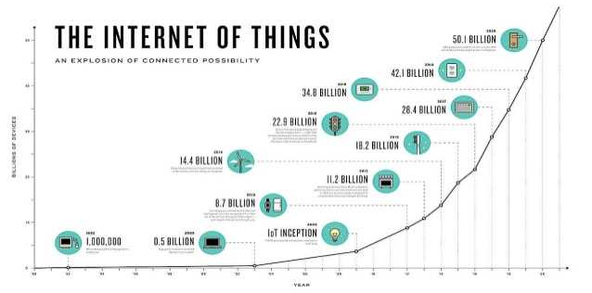
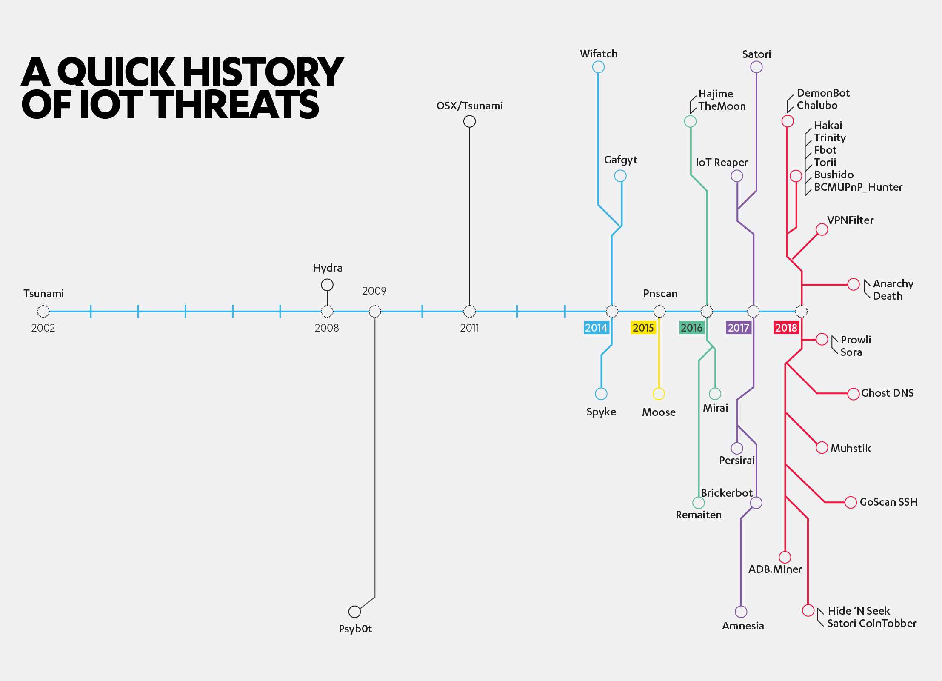
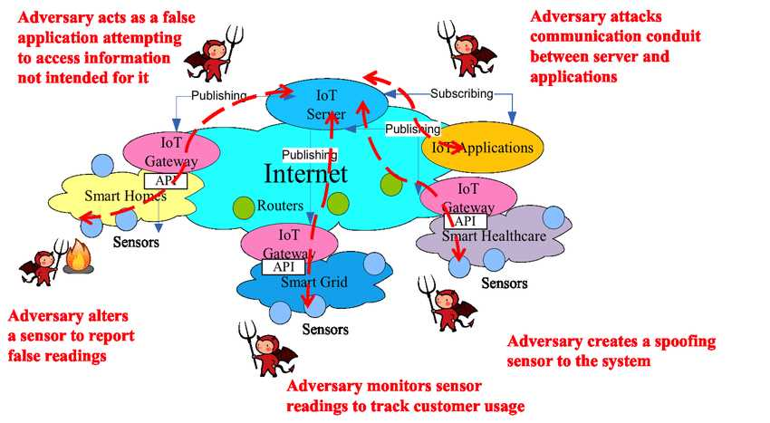
::.. Landscape of IoT security
We are witnessing a dramatic increase of smart devices being deployed to support various kinds of projects and applications.
Recently, hacking events targeting IoT devices have increased, with negative effects achieving higher impacts.

Slide 3
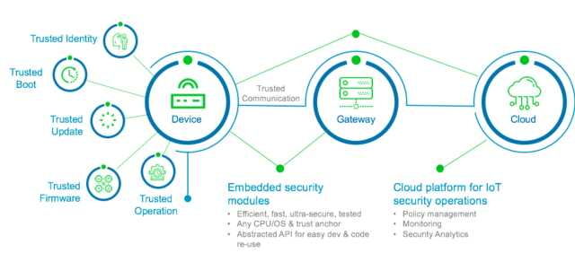
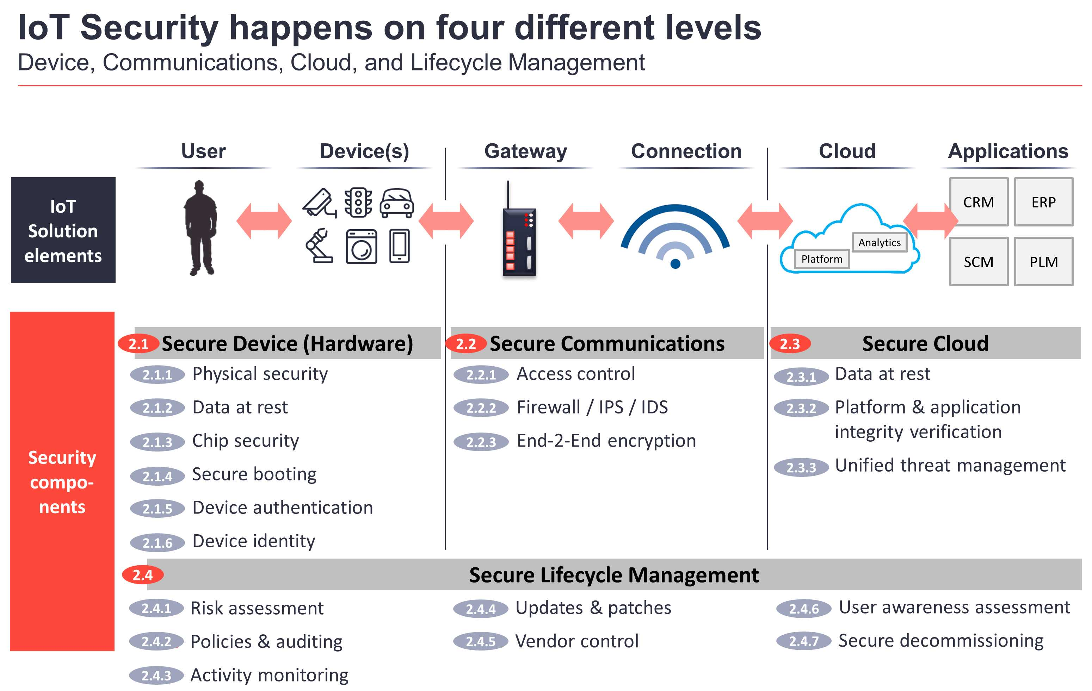
::.. Landscape of IoT security
IoT Security is very challenging as it involves multiple aspects and requires heterogeneous competences.
IoT security protects against both physical and logical security threats.

Slide 4
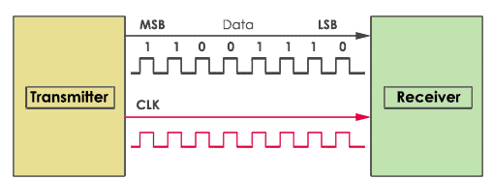

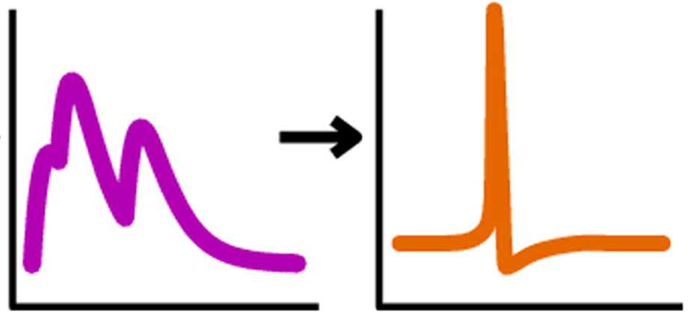


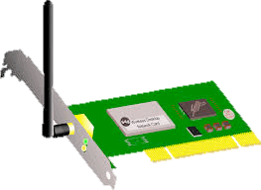
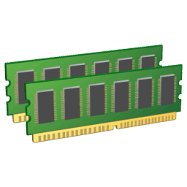

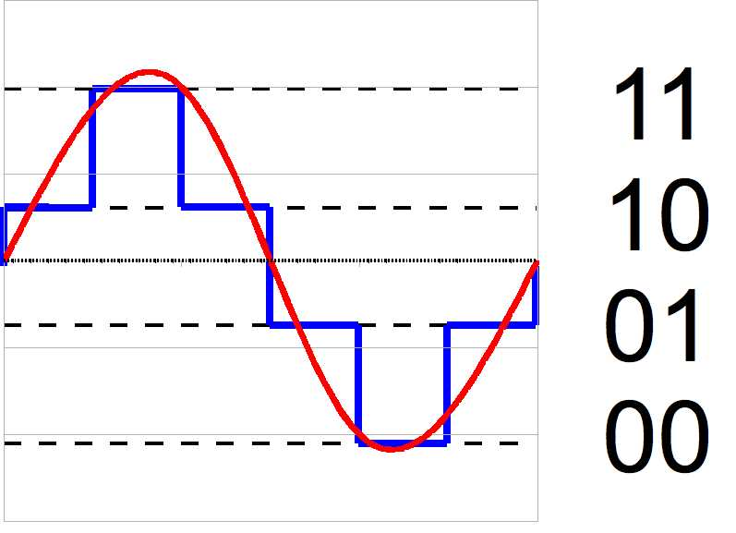
::.. Serial Comm in IoT Nodes
An IoT node is made of a board equipped with various hardware entities communicating among each other by using serial communication protocols.
Local User
Interface
Signal Conditioning
Processor Algorithms Exec.
Network Interface
Physical Features Measuring
NETWORK
Analog-Digital Conversion
Memory Data Storage
Battery
Actuator

Slide 5


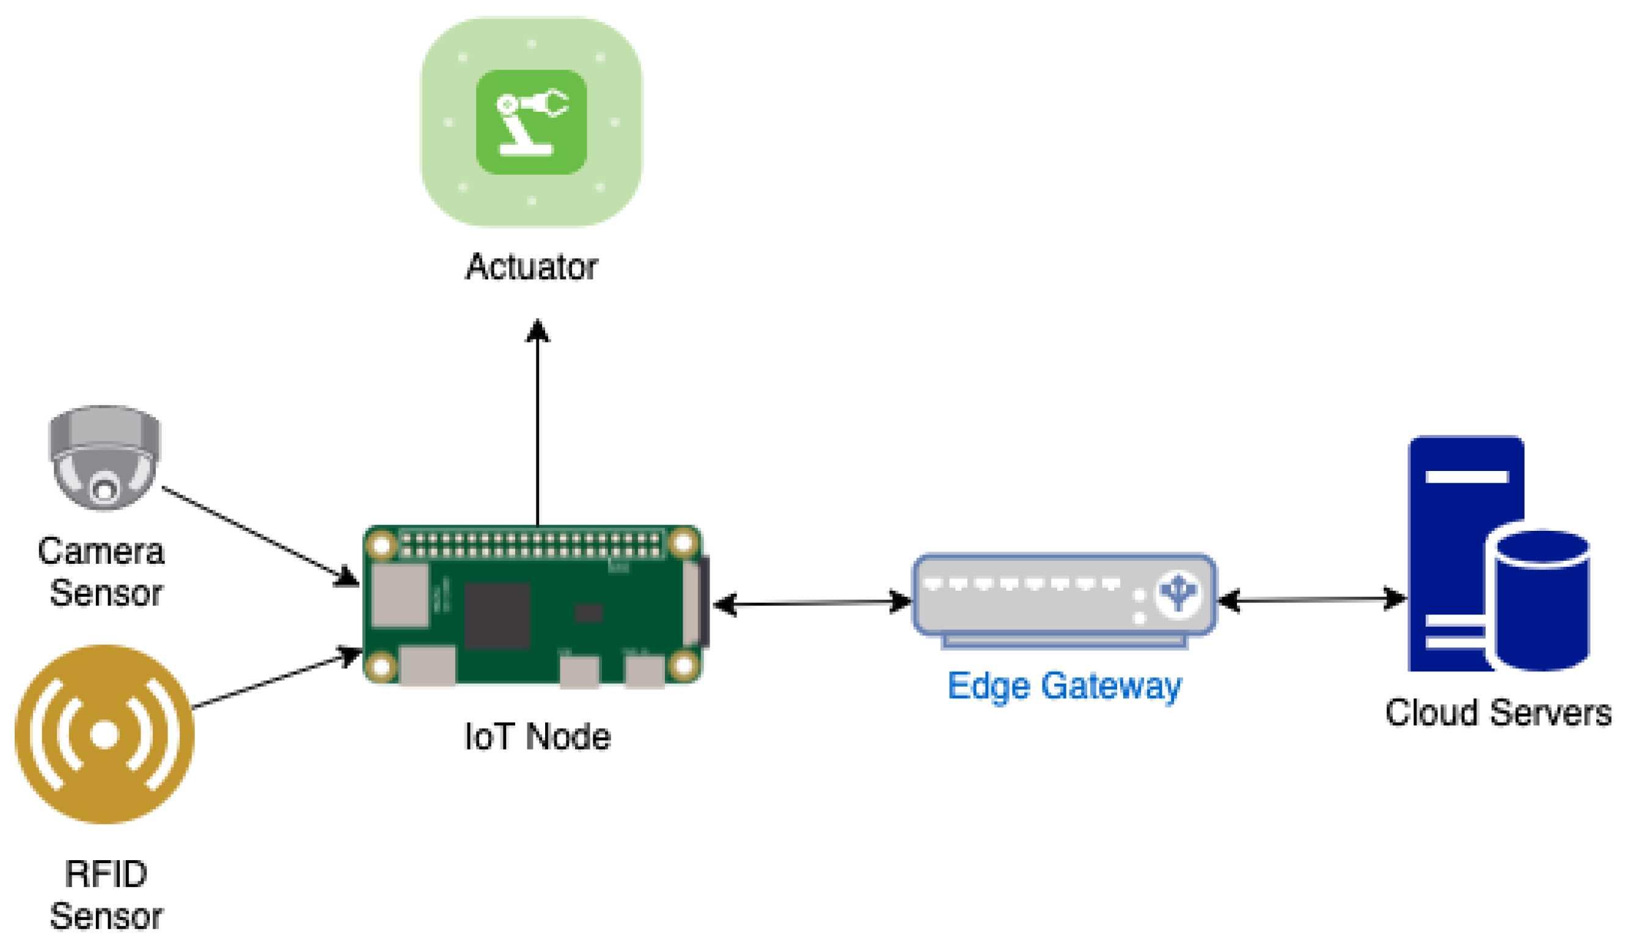
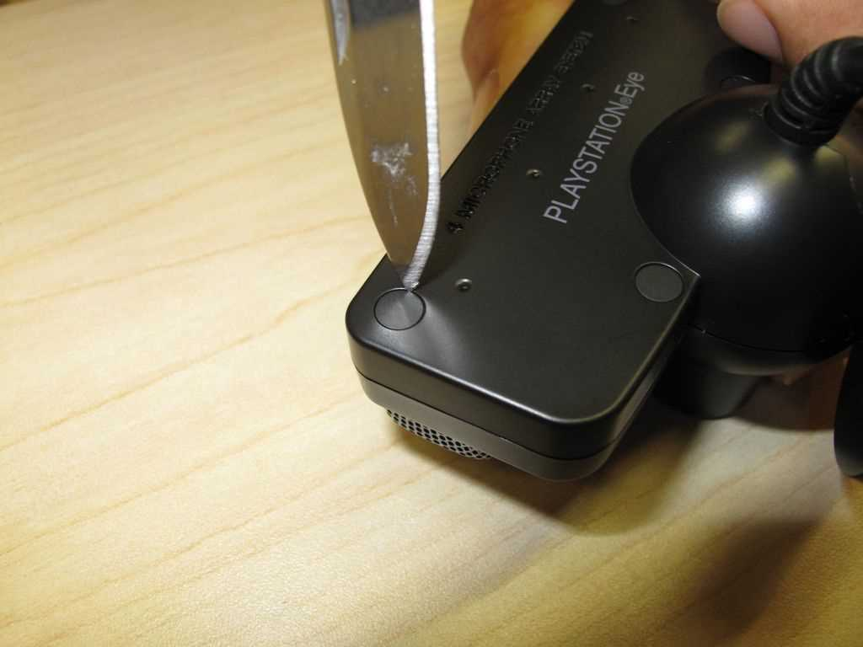
::.. IoT Nodes Capture
One of the possible attacks to the IoT devices is the node capture: an adversary gains full control of IoT devices through direct physical access.
The impact of this attack can be marginal if negligible information is stolen, or greater if routing, data provisioning and/or other critical capabilities are affected.
Devices expose communication interfaces to be exploited to gain access to the device and perform malicious actions, such as gain logs or unauthenticated root shell on the target device.
An internal inspection is performed by opening it up and looking at its internal components, or the Federal Communication Commission (FCC) ID may come in help by querying a db available on line with valuable infos.

Slide 6
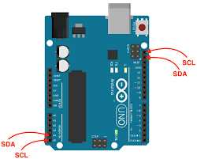
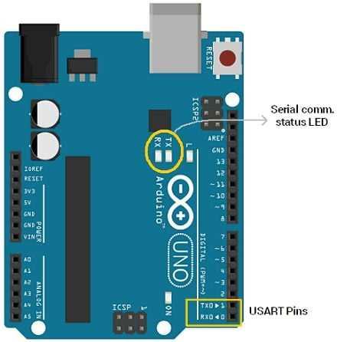
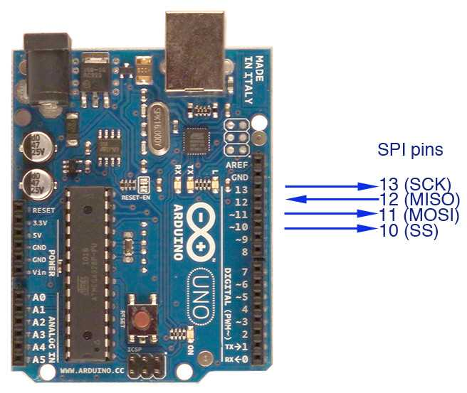
::.. Serial Comm in IoT Nodes
Arduino board is equipped with pins for the UART, SPI and I²C protocols. These protocols can be used during bootstrapping to make a dump of the firmware running on the node, or to intercept messages exchanged among the node components.
I²C pins
I²C pins

Slide 7
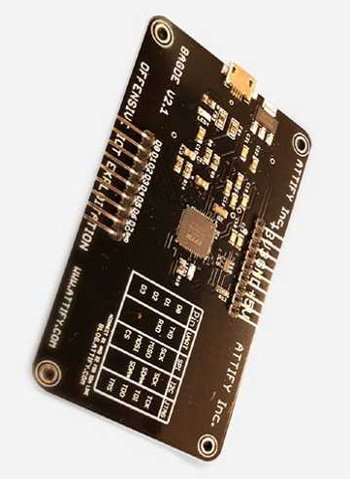
::.. Serial Comm in IoT Nodes
Arduino board is equipped with pins for the UART, SPI and I²C protocols. These protocols can be used during bootstrapping to make a dump of the firmware running on the node, or to intercept messages exchanged among the node components.
I²C pins
I²C pins
The Attify Badge is a multipurpose tool for hacking by means of serial comm.

Slide 8
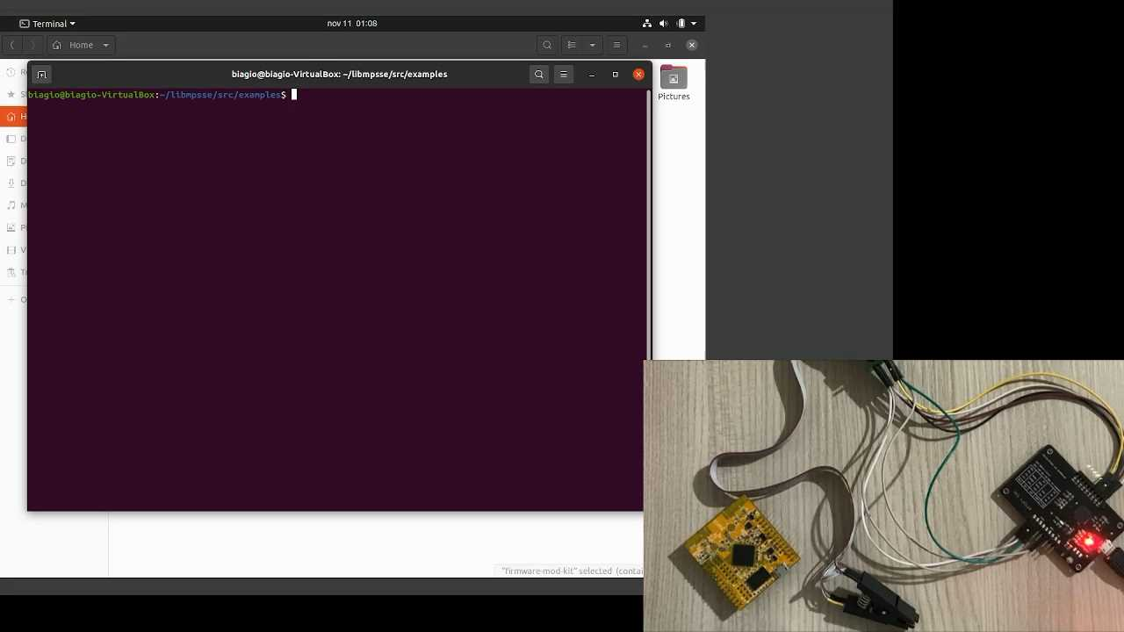
::.. SPI Exploitation

Slide 9
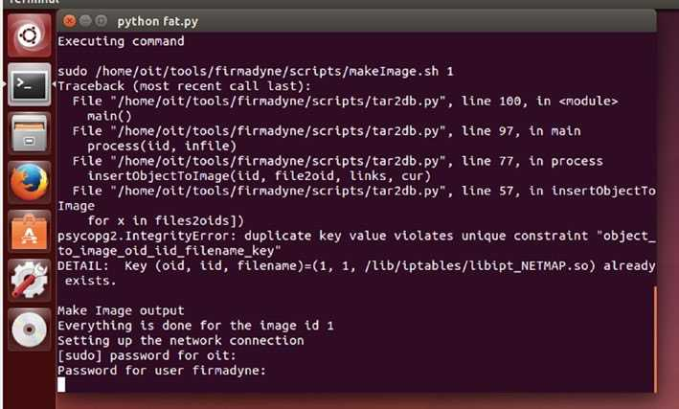
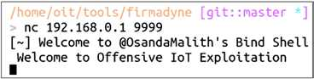
::.. SPI Exploitation

Slide 10
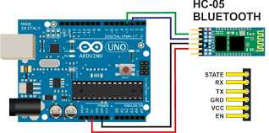
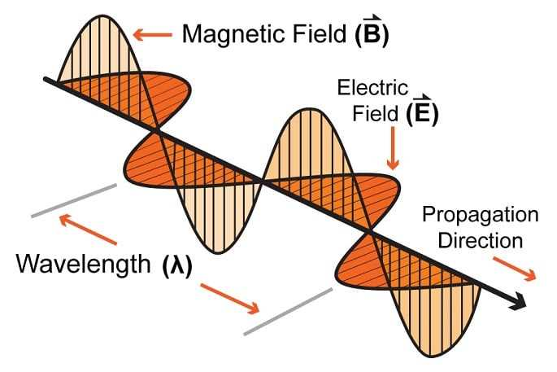
::.. BT Communications
An IoT system is an interconnection of devices by means of wireless ad-hoc networks leveraging on Bluetooth, WiFi, Zigbee, and so on.
These protocols represent messages as RF signals, exchanged within the air from an emitting station to a receiving one.
It is possible to sniff the packets exchanges between two nodes over a BT channel.

Slide 11
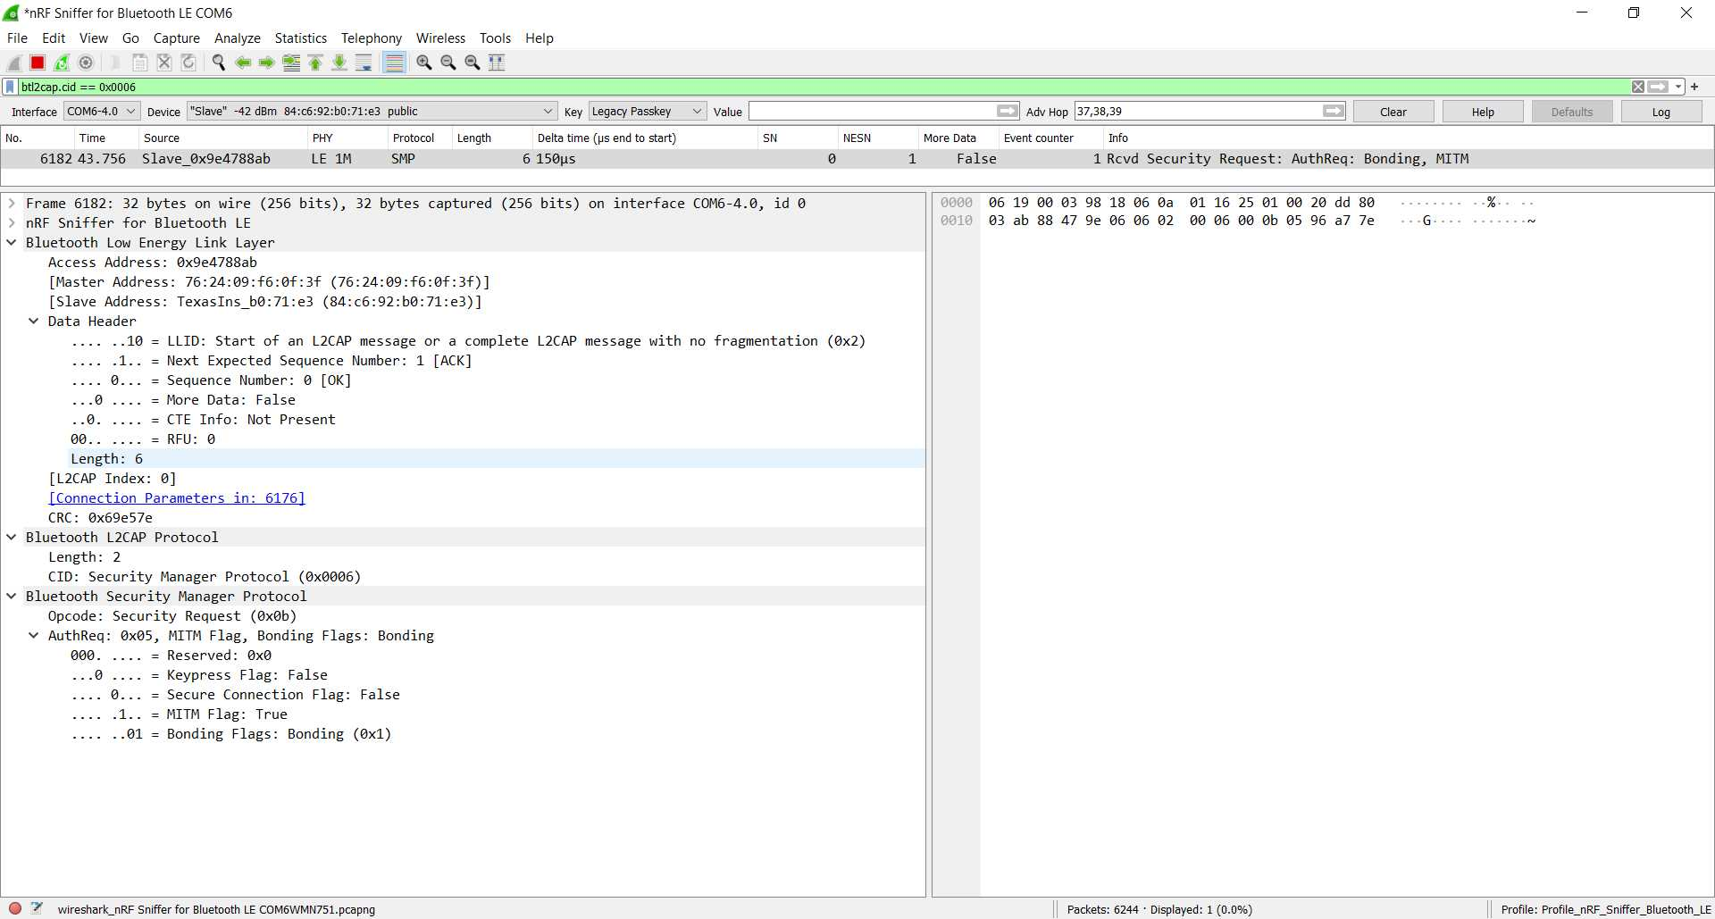
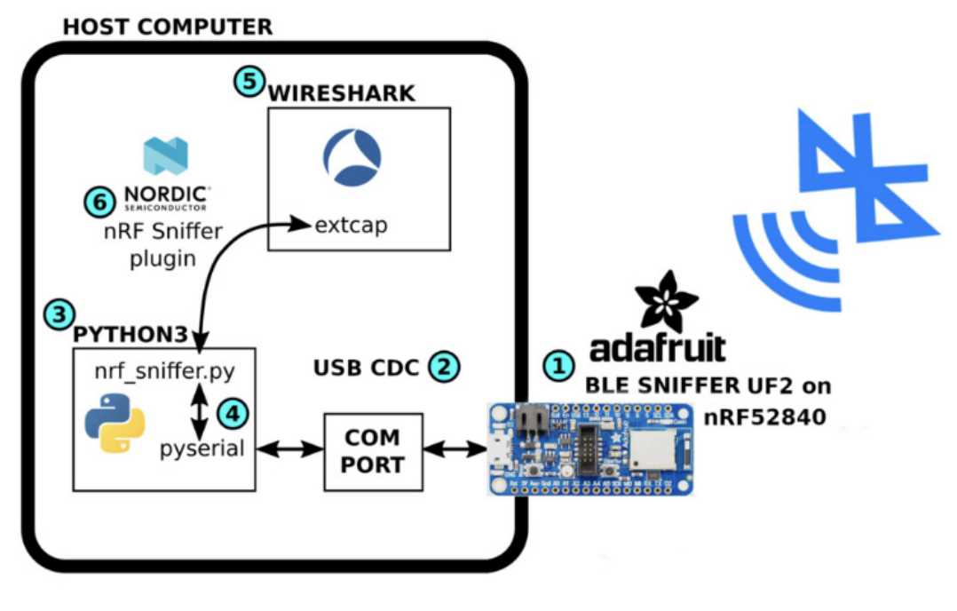
::.. BT Communications Hacking
The sniffed messages by using Adafruit sniffer can be passed to the Wireshark application to visualize the message content.

